Slide 1


IMPROVING WAREHOUSE OPERATIONS OF NAMET THROUGH LAYOUT REDESIGN- A KAIZEN IMPLEMENTATION

Slide 2
Members of Project
Ege Dağcı
Rebecca Sadeghi
Yeliz Altan
Mert Saylam
Nükhet Karagöz
Academic Advisor
Aysu Göçer
Industrial Advisor
Feyza Türk

Slide 3
OUTLINE
Introduction
  About Namet
  About Netsis
  Motivation of the Project
  Expectations and Challenges
Project Proposal
  Background of the Problem
      Function of a Warehouse
      Warehouse Layout Problem
      Warehouse Redesign
    ii. Problem Definition
    Literature Review
    Objective of the Project
    Methodology
Project Plan
  Work-Breakdown Structure
  Gantt Chart
Project Progress
References

Slide 4

INTRODUCTION
Established in 1929
Cold warehouse
(Aegean Reagion)
Factory in Gebze
Kayarlar Group
Family Coorparation

Slide 5
INTRODUCTION
PRODUCTS
Pastrami
Sausage
Fried meat
Salami
Bacon
MISSION
VISSION
Indispensable brand
High quality
Great delicious
Healty meats
Hygienic environment
Expand internationally
Customers thoughts and opinions
Grow supply chain
importance to their employees
VALUES
Protection of human life
Not wasting natural sources
Obey legal laws
Increase quality

Slide 6
INTRODUCTION
Namet
Netsis Software
to manage warehouse operations

Slide 7
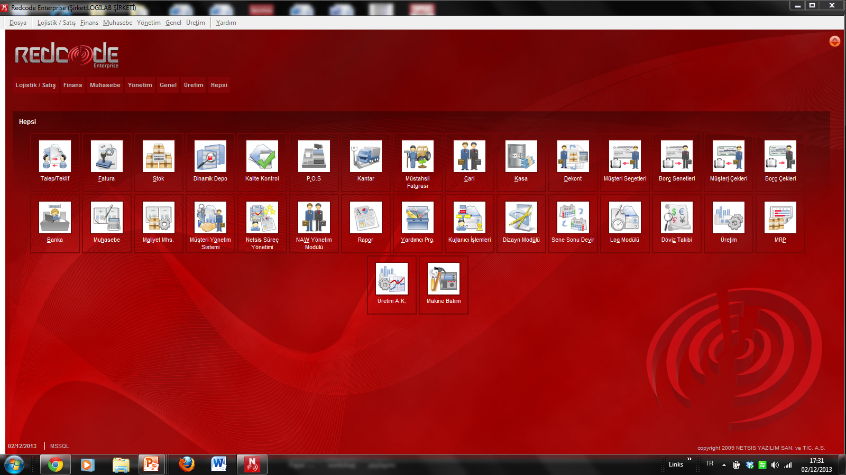

Slide 8
INTRODUCTION
Established in 1991
Corporate business software
End to end business for 40.000 entities
Use warehouse layout design module

Slide 9
INTRODUCTION
Motivation
Expectation
Challenges
Real life problem
Netsis on running the warehouse software module
Experience a warehouse / cold storage, software module
Direct communication with the managers / employees
Job opportunities
Job opportunities
Satisfying the course objectives
Solution to be implemented by the company
Kaizen implementation in Cold Storage
Temperature Sensitive Products
Netsis Warehouse Software Module
Meat Industry
Seasonality
Data Collection / Information Gathering

Slide 10
Background of the Problem
SUBJECT | SENTENCES | REFERENCES
Function of Warehouse | Receiving,identification, Sorting, dispatching to storage,placing in storage,storage,retrieval from storage, order accumulation,packing, shipping,record keeping,... | Tompkins and White, 1984
Issues in Warehouse Layout | maximize space utilization; equipment utilization; labor utilization; accessibility of all materials ; protection of all materials storing goods in adequate space with the proper equipment by well trained personnel in a properly planned layout results in maximum protection of items. | Tompkins et al., 1996
The main problems in a warehouse | Storing,architectural design and general layout problem, picking, response time for the order processing, minimization of travel distances in the warehouse, routing of pickers or automated guided vehicles (AGV). | Vrysagotis and Kontis, 2011
The primary objectives of warehouse redesign are to | use space efficiently,allow for the most efficient material handling,provide the most economical storage in relation to costs of equipment,use of space, damage to material, handling labor and operational safety and logistics cost reduction. | Hudock and Tompkins, 2013 Xia et al. 2009 Ballou, 2004
Steps in Warehouse Redesign: | Measure the space you have to work with, define the fixed obstacles (columns, walls, doors, clearances, etc.),understand the product stored and handled,define storage condition zones, through put/replenishment requirements, unit handling loads, establish the material flow paths, | Hudock and Tompkins, 2013

Slide 11
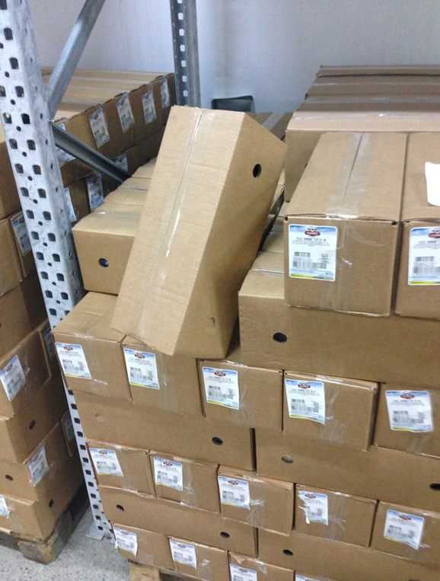
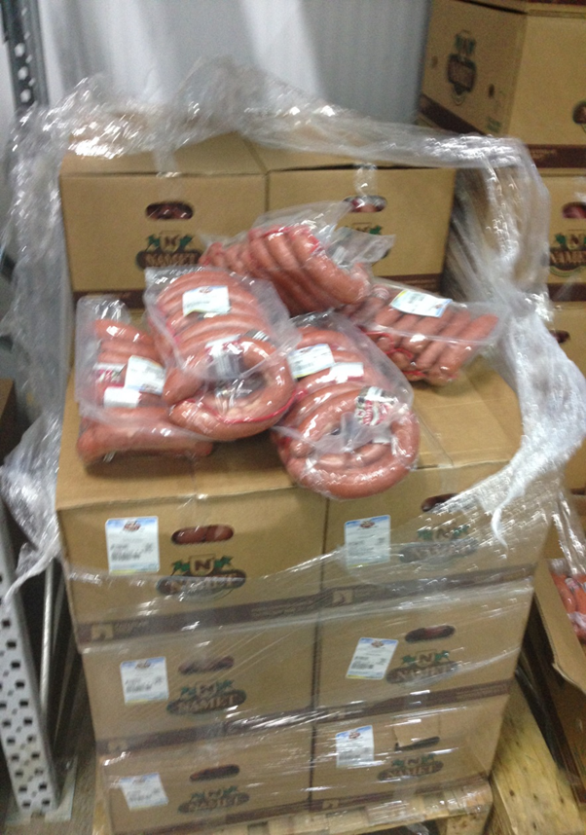
PROBLEM DEFINITION
Namet is facing problems in…
Efficient use of space
Product Addressing
FIFO Strategy
Disordered products/vehicles/equipments
Order Picking

Slide 12
The Objective is to
Improve the Warehouse Operations of Namet through Warehouse Layout Redesign
Warehouse Layout
Pareto
Analysis
Netsis
Kaizen
Warehouse Operations Mapping
5S

Slide 13
METHODOLOGY
FIELD NOTES
INTERVIEWS
With employees
Weekly visits to Namet warehouse
OBSERVATION
Spend 10 hours per week for observing the daily operations in the warehouse for 10 weeks of period
Company managers
Other executives (e.g. experts on Kaizen implementations)
Warehouse processes observations notes.

Slide 14

What is Kazien?
Benefits of Kazien
Japanese term for continuous improvement, using common sense and is both a rigorous, scientific method using statistical quality control and an adaptive framework of organizational values and beliefs that keeps workers and management focused on zero defects.
(Barnes,T.,1996)
waste-inventory, time
turnover
space utilization
product quality
employee moral
jop satisfaction
(Barnes,T.,1996)

Slide 15
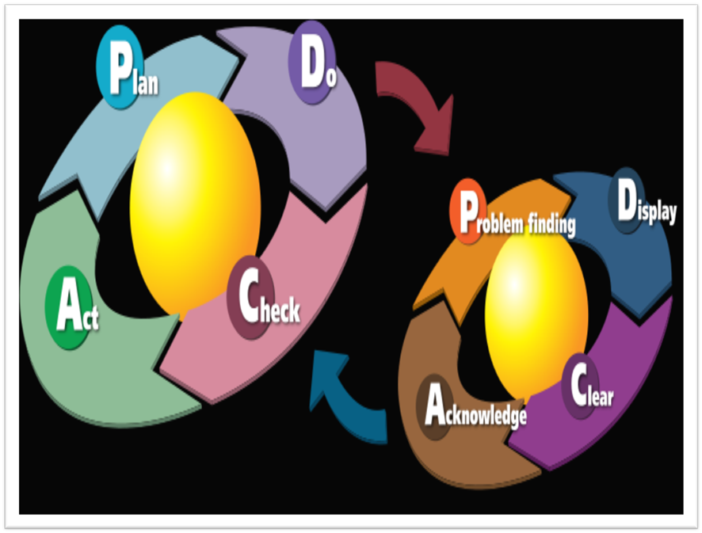
The Cycle of Kaizen
Standardize an operation and activities.
Measure the operation (find cycle time and amount of in-process inventory).
Gauge measurements against requirements.
Innovate to meet requirements and increase productivity.
Standardize the new, improved operations.
Continue cycle ad infinitum.
(Barnes,T.,1996)

Slide 16
we will prepare the Template for
5S
(the very initial method of Kaizen)
to be implemented in Namet Cold Warehouse (Aegean Region)

Slide 17
What is 5S?
Benefits of 5S
Sort : remove unnecessary items from the workplace.,
Set in order: locate everything at the point of use.,
Shine : clean and eliminate the source of filth,
Standardize : make routine and set standards for best practices
Sustain: by making the 5S second nature.
(Iva Gergova, 2010)
quality
productivity
customer confidence
waste
costs
(Steve Jonathan,2013)

Slide 18
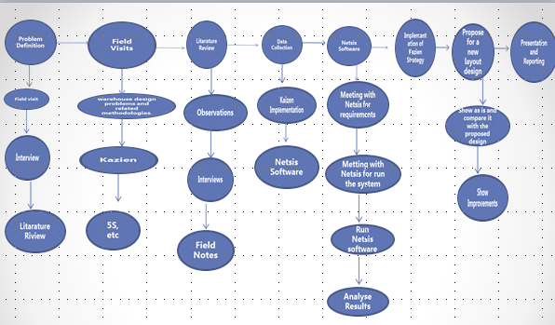
WORK BREAKDOWN STRUCTURE

Slide 19
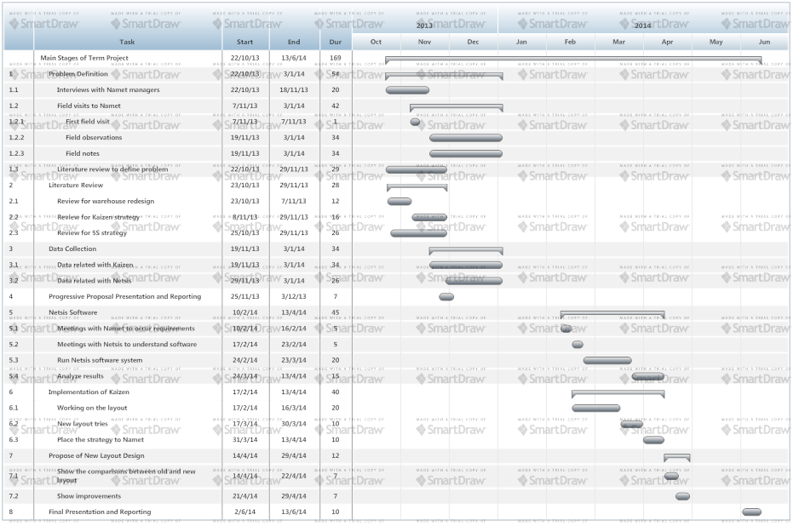
GANTT CHART

Slide 20
PROJECT PROGRESS
(completed)
Problem Definition
Literature Review
Observations in the warehouse : 14 field visits (700 hours) to Namet warehouse
Interviews with Namet managers / workers
Warehouse Operations Process Mapping
5S Templates
  5S Layout Template
  5S Audit Template
Pareto Analysis (initial version – ongoing…)

Slide 21
WAREHOUSE OPERATIONS PROCESS MAPPING
Order
Picking
Loading
Unloading

Slide 22
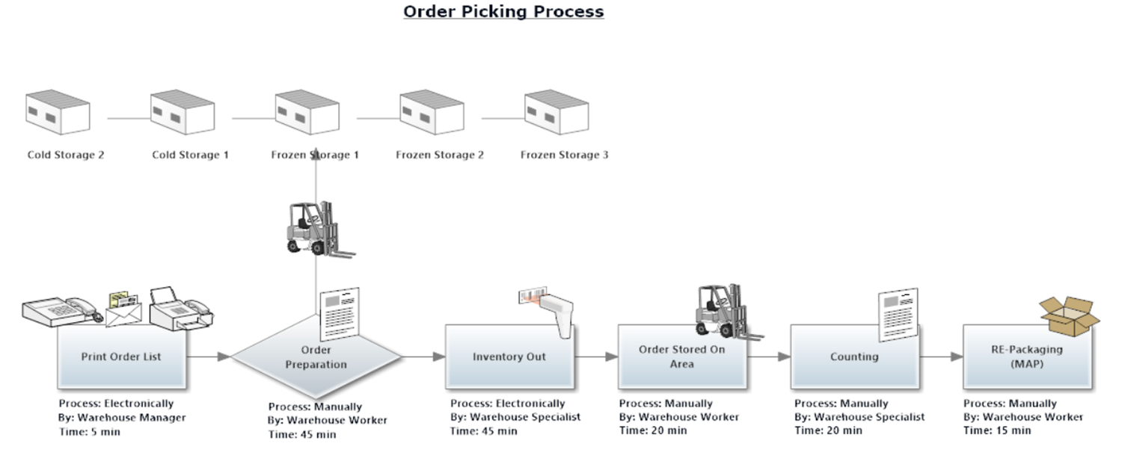

Slide 23
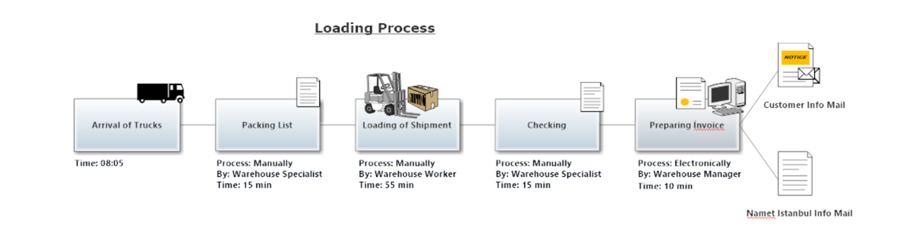

Slide 24
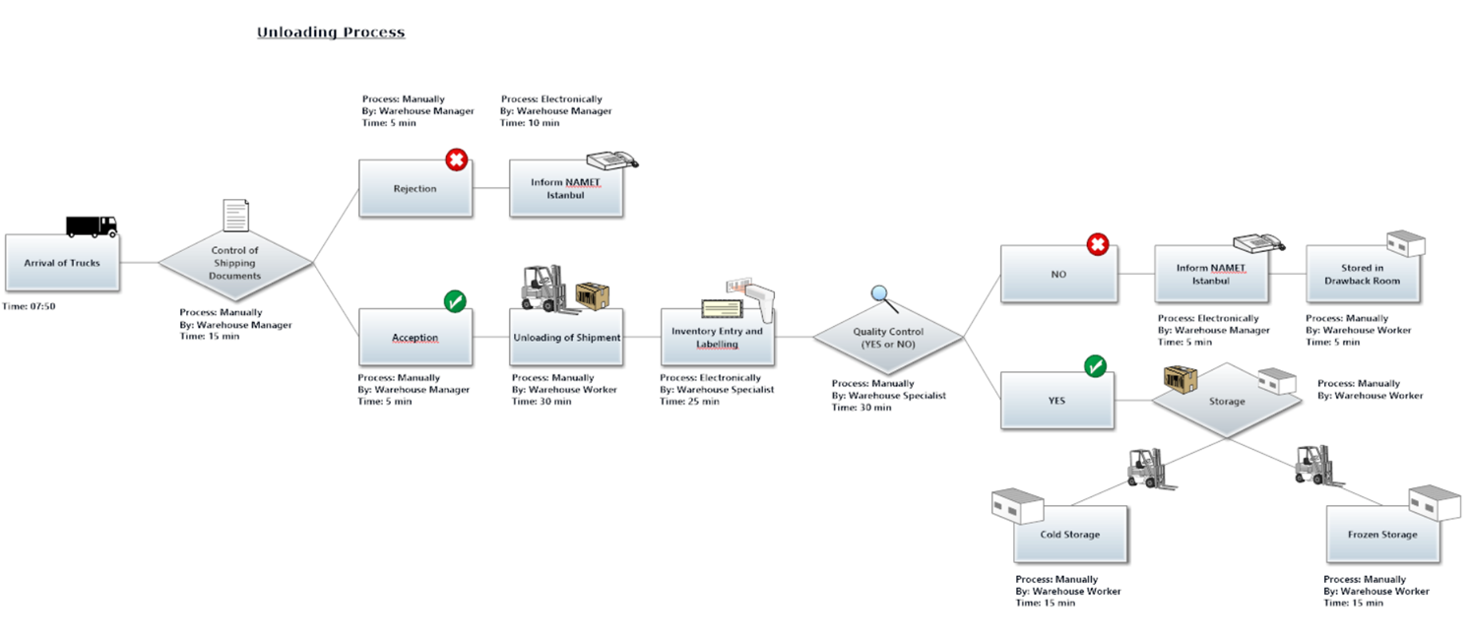

Slide 25


TO START WITH 5S...
Necessary
Signboards

Slide 26
TO START WITH 5S...
Neccesary
Equipments and
Personel
Wall Panel
Name Badge
Supply Scheme
Rearview Mirror
Cleaner
Mobile Label

Slide 27
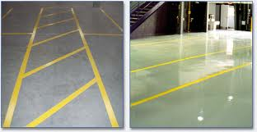
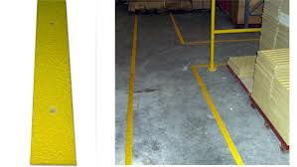
TO START WITH 5S...
Area
and
Lines
Forklift Line
Fire Extinguisher Area
Portable Terminal, Weighing Machine and Trash Bin Area

Slide 28
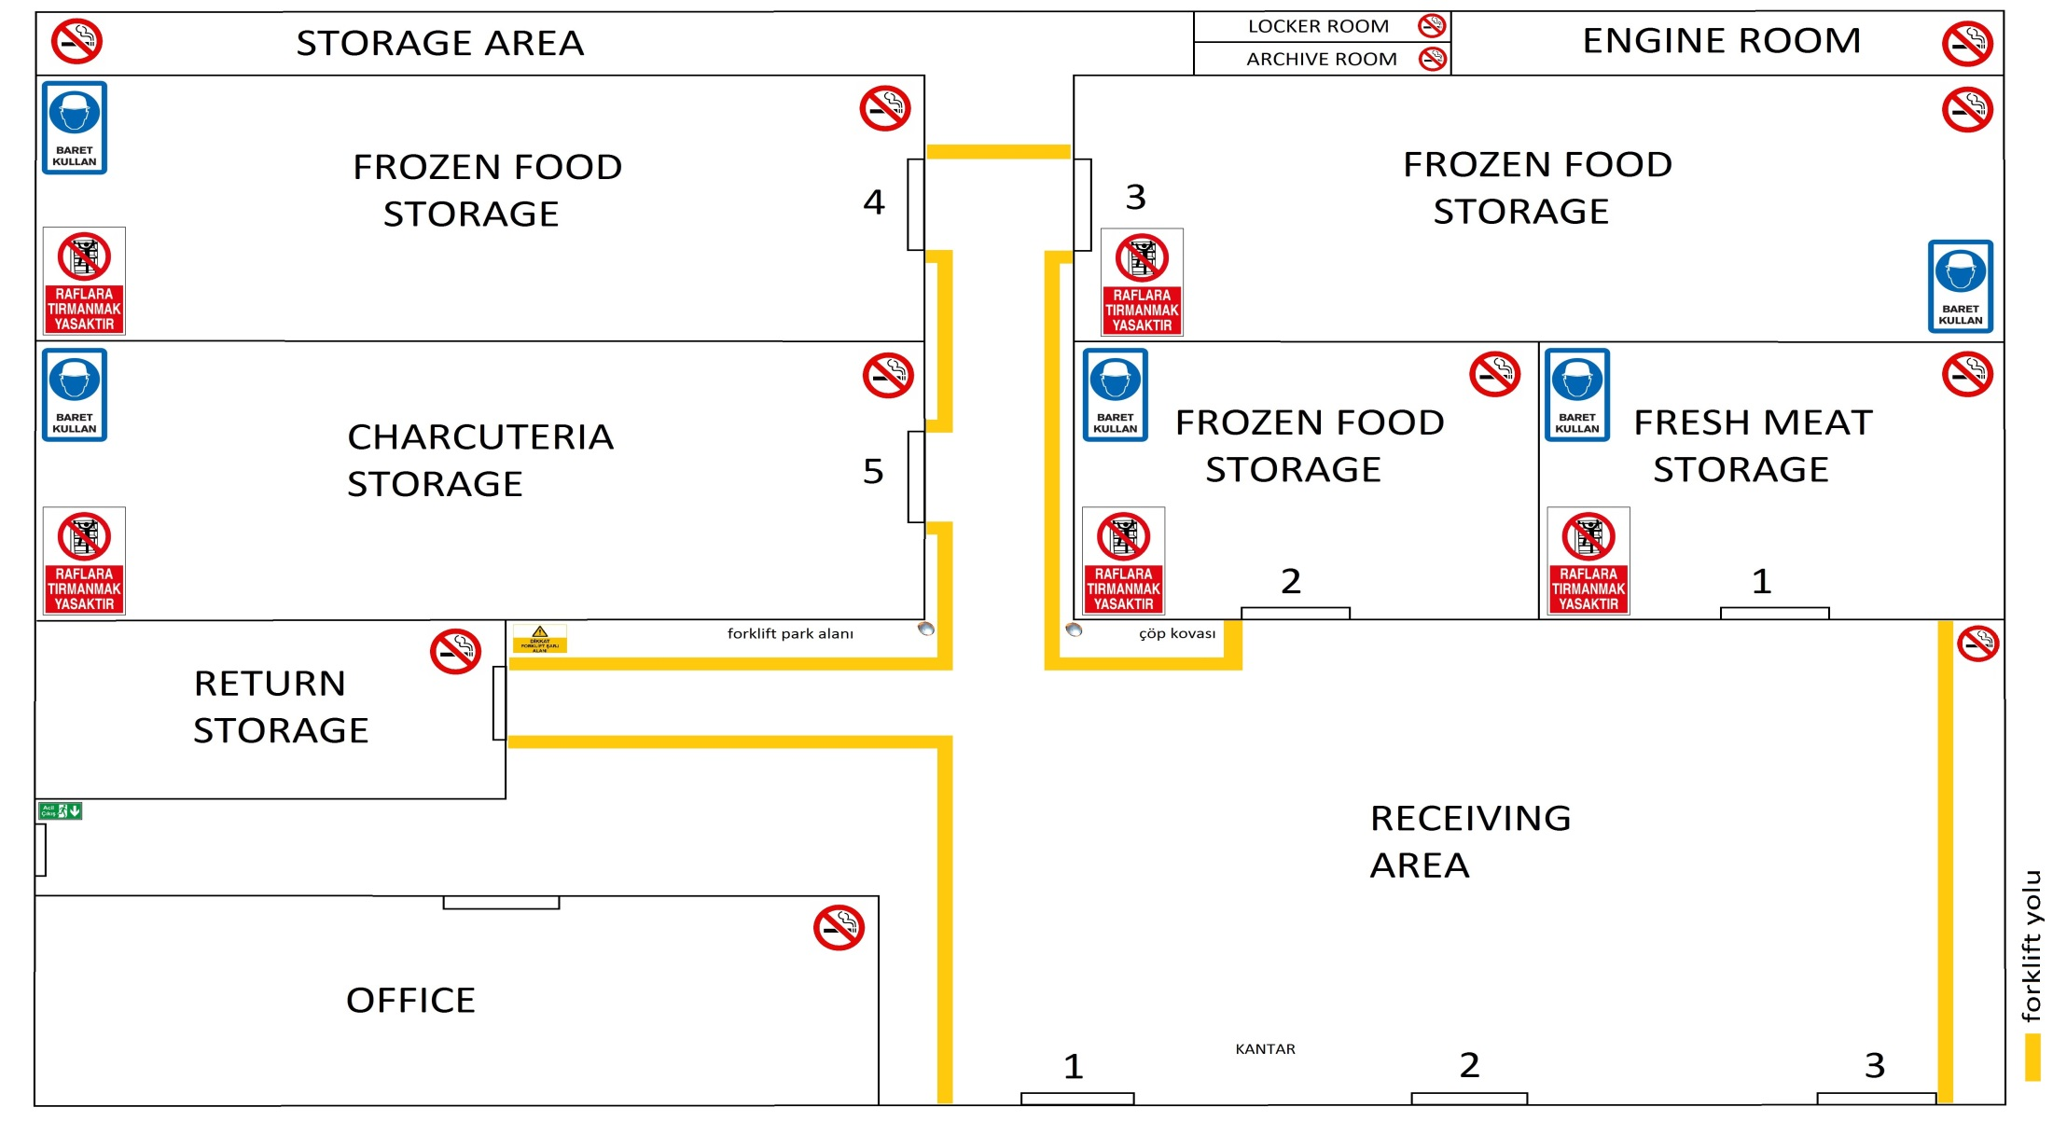
5S TEMPLATE LAYOUT

Slide 29
5S QUESTIONS FOR
COLD WAREHOUSE
1S- SORTING
Unnecessary meat boxes move away from the warehouse.
Unnecessary or damaged machines and equipments move away from the warehouse.
Unnecessary gauge, measuring tool and other equipments move away from the warehouse.
Standart work documents are published.
Jop instruction documents are published.
Warning signs and jop security documents are published
Meat quality lists are published and up-to-date.
There is a fire extinguisher.
There is not any damaged place.
There is not any dangerous stuation.

Slide 30
5S QUESTIONS FOR
COLD WAREHOUSE
2S- STREAMLINING
Meat boxes are defined with labels.
Shelfs are defining with labels.
Maximum and minimum stock quantities are defined.
Walking ways are defined in warehouse.
Warehouse rooms are defined.
Fire extinguishers are easily reachable.
Scarp room is tidy and equipments are labeling.
Finding a missing equipments can be easily.
There is not any missing in 1S level.

Slide 31
5S QUESTIONS FOR
COLD WAREHOUSE
3S –SYSTEMATIC CLEANING
Shelfs, equipments fetch, rooms are clean.
Corridors and empty areas are clean.
Specific cleaning duties are defined in warehouse.
Cleaning equipments are avaliable and putting in a defined place.
Trash bin and jerrycan are avaliable.
Trash bin and jerrycan are placing in defined places.
Daily shelfs and room cleaning is making.
Labels, cautionary signals, panels are noticable and clean.
There are not any missing in 1S and 2S levels.
There are accountable person for 5S and hi/her giving education about 5S.

Slide 32
5S QUESTIONS FOR
COLD WAREHOUSE
4S - STANDARDIZE
5S control results are published regularly.
Cleaning rules, duties, programs and procedures are writing and reachable.
There is a right lightining.
There is an active air condition.
There is conteyners for recycling.
Garbages are regularly emptied.
Scarp area regularly cleaning.
There is an area for smooking and resting.
Workers are wearing same clothes.
There are not any missing in 1S, 2S and 3S levels.

Slide 33
5S QUESTIONS FOR
COLD WAREHOUSE
5S - SUSTAIN
Daily cleaning is making and keeping records.
All workers are aware and educated for cleaning and order.
All procedures and instructions regularly controlling and up-to-date.
Panels are orderly and up-to-date.
In meetings they are sparing the time for 5S and recording performance metrics.
There are not any missing in 1S, 2S, 3S and 4S levels.

Slide 34
5S AUDIT TEMPLATE
5S Denetim Şablonu 2013.xlsx (flash bellek)

Slide 35
PARETO ANALYSIS
(INITIAL VERSION)
Main Product Types in Namet
Storage Places: Storage 2, 3 and 4
Delicatessen
Storage Place: Storage 5
Frozen Meat
Stocking Time: at most 1 year
Moving in Warehouse: 2 tones in a week
On 1 Pallet: 750 kg, approxiamte 1 tone
In 1 Storage with Shelves: 168 pallets
Stocking Time: at most 1 week
Moving in Warehouse: approximate 5 tones in a week
On 1 Pallet: average 400 kg

Slide 36
PARETO ANALYSIS
(INITIAL VERSION)
Main Product Types in Namet
Fresh Meat
Storage Area: Storage 1
Stocking Time: at most 1 day
Moving in Warehouse: 2 tones in a week
On 1 Pallet: 750 kg
Frozen Delicatessen
Storage Places: Storage 2, 3 and 4
Stocking Time: at most 1 week
Moving in Warehouse: 1 tones in a week
On 1 Pallet: average 400 kg

Slide 37
PARETO ANALYSIS
(INITIAL VERSION)
Main Product Types in Namet
Map
Storage Area: Storage 1
Carcass Meat
Storage Area: Storage 1
Stocking Time: at most 1 day
Moving in Warehouse: 4 tones in a week
On 1 Pallet: average 400 kg
Stocking Time: at most 1 day
Moving in Warehouse: 4 tones in a week
On 1 Slide: average 5 pieces

Slide 38
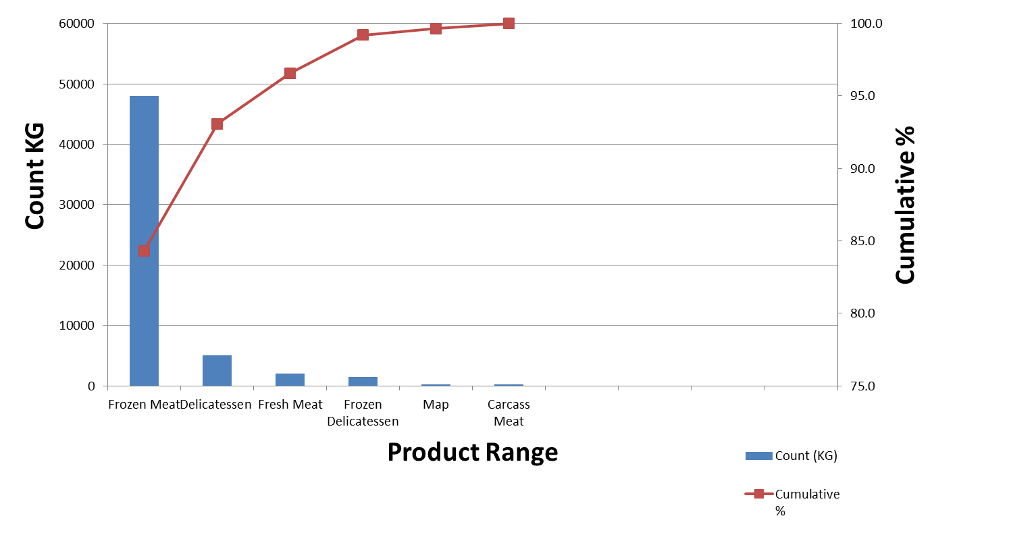
Graph of Pareto Analysis for Namet

Slide 39
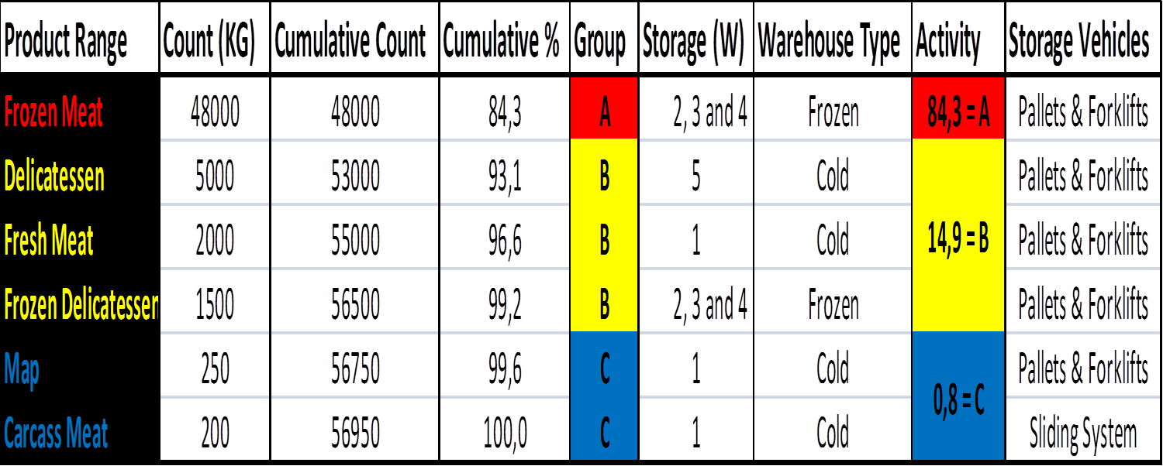
PARETO ANALYSIS
(INITIAL VERSION)

Slide 40
PROJECT PROGRESS
What is left...?
Pareto Analysis
Run Netsis Warehouse Design Module
Warehouse Redesign Proposal

Slide 41
REFERENCES
www.namet.com.tr
www.netsis.com.tr
Tompkins, James A. and White, John A. Facilities Planning, John Wiley and Sons, New York, 1984.
Tompkins et al. Facilities Planning, 2nd. ed., John Wiley and Sons, New York, 1996.
Vassilios V. and Patapios A. K.(2011) .Warehouse layout problems : Types of problems and solution algorithms. Journal of Computations & Modelling,1(1), 131-152
Brian H.(2004). How to Maximize Warehouse Space When Expansion Isnt an Option. Retrieved from:http://www.tompkinsinc.com
Xia, L.X.X., Lim, R., and Yu, W. (2009). Redesigning A Distribution Network in A Supply Chain: A Case Study. Proceedings of the International Conference on Industrial Informatics, IEEE, 729-733.
Ballou, R.H. (2004). Business logistics/supply chain management: Planning, organizing, and controlling the supply chain. Prentice Hall, Upper Saddle River, NJ.
Roman B., Miquel A. P. (2008). Warehouse redesign to satisfy tight supply chain management constraints. WSEAS Transaction on Information Science& Applications,
5(3), 286-291
Barnes,T. Kaizen Strategies for Successful Leadership, Pitman Publishing, London, 1996.
Iva G. (2010). Warehouse improvement with Lean 5S - A case study of Ulstein Verft AS (Master's thesis). Molde University Colledge, Molde, Norway.
Steve J. (2013). The Advantages of 5S. Retrieved from: http://www.ehow.com/info_8061038_advantages-5s.html.
Mitch M. (2010). Streamlining Warehouse Operations with Lean Six Sigma. Retrieved from: http://ezinearticles.com/?Streamlining-Warehouse-Operations-Using-Lean-Six-Sigma&id=3989660.

Slide 42


